Slide 1
What is RAID
Redundant Array of Independent (Inexpensive) Disks
A set of disk stations treated as one logical station
Data are distributed over the stations
Redundant capacity is used for parity allowing for data repair

Slide 2
RAID (Redundant Array of Independent Disks)
Redundant array of inexpensive disks
Multiple disk database design
Set of physical disk drives viewed by the OS as a single logical drive
Data are distributed across the physical drives of an array
Improve access time and improve reliability
  large storage capacity
  redundant data
  7 levels (6 levels in common use)
  - differing levels of redundancy, error checking, capacity, and cost

Slide 3
Striping
Take file data and map it to different disks
Allows for reading data in parallel
file data
block 0
block 1
block 2
block 3
Disk 0
Disk 1
Disk 2
Disk 3

Slide 4
Parity
Way to do error checking and correction
Add up all the bits that are 1
  if even number, set parity bit to 0
  if odd number, set parity bit to 1
To actually implement this, do an exclusive OR of all the bits being considered
Consider the following 2 bytes
byte parity
10110011 1
01101010 0
If a single bit is bad, it is possible to correct it

Slide 5
Mirroring
Keep two copies of data on two separate disks
Gives good error recovery
  if some data is lost, get it from the other source
Expensive
  requires twice as many disks
Write performance can be slow
  have to write data to two different spots
Read performance is enhanced
  can read data from file in parallel

Slide 6
Levels of RAID
6 levels of RAID (0-5) have been accepted by the industry
Other kinds have been proposed in literature
Level 2 and 4 are not commercially available, they are included for clarity

Slide 7
RAID 0
All data (user and system) are distributed over the disks so that there is a reasonable chance for parallelism
Disk is logically a set of strips (blocks, sectors,…). Strips are numbered and assigned consecutively to the disks (see picture.)

Slide 8
Raid 0 (No redundancy)
strip 0
strip 1
strip 2
strip 3
strip 4
strip 5
strip 6
strip 7
strip 8
strip 9
strip 10
strip 11
strip 12
strip 13
strip 14
strip 15

Slide 9
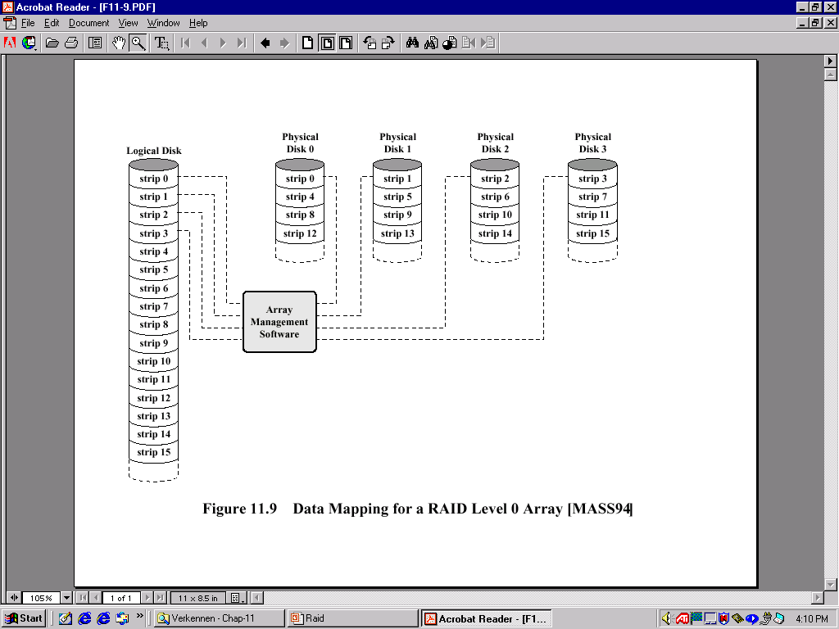
Data mapping Level 0

Slide 10
RAID 0
Block level stripping
Without parity or mirroring
No redundancy, No backup, No fault tolerance
Improved performance, faster, as it is uses block level stripping
Maximum use of storage space as there is no backup
Any drive failure destroys the array

Slide 11
Raid 1 (mirrored)
strip 0
strip 1
strip 2
strip 3
strip 4
strip 5
strip 6
strip 7
strip 8
strip 9
strip 10
strip 11
strip 12
strip 13
strip 14
strip 15
strip 0
strip 1
strip 2
strip 3
strip 4
strip 5
strip 6
strip 7
strip 8
strip 9
strip 10
strip 11
strip 12
strip 13
strip 14
strip 15

Slide 12
RAID 1
RAID 1 does not use parity, it simply mirrors the data to obtain reliability
Plus:
  Reading request can be served by any of the two disks containing the requested data (minimum search time)
  Writing request can be performed in parallel to the two disks: no “writing penalty”
  Recovery from error is easy, just copy the data from the correct disk
Minus:
  Price for disks is doubled
  Will only be used for system critical data that must be available at all times

Slide 13
Mirroring
Without parity
Data is written identically to two drives (parallel write)
Not slower, not faster (Write)
Read can be faster by parallel access
Fault tolerance
50% storage space can be used

Slide 14
Raid 2 (redundancy through Hamming code)
b₀
b₁
b₂
b₂
f₀(b)
f₁(b)
f₂(b)

Slide 15
RAID 2
Small strips, one byte or one word
Synchronized disks, each I/O operation is performed in a parallel way
Error correction code (Hamming code) allows for correction of a single bit error
Controller can correct without additional delay
Is still expensive

Slide 16
RAID 3 (bit-interleaved parity)
b₀
b₁
b₂
b₂
P(b)

Slide 17
RAID 3
Level 2 needs log₂(number of disks) parity disks
Level 3 needs only one, for one parity bit
In case one disk crashes, the data can still be reconstructed even on line (“reduced mode”) and be written (X1-4 data, P parity):
  P = X1+X2+X3+X4
  X1=P+X2+X3+X4
RAID 2-3 have high data transfer times, but perform only one I/O at the time so that response times in transaction oriented environments are not so good

Slide 18
RAID 4 (block-level parity)
block 0
block 1
block 2
block 3
P(0-3)
block 4
block 5
block 6
block 7
P(4-7)
block 8
block 9
block 10
block 11
P(8-11)
block 12
block 13
block 14
block 15
P(12-15)

Slide 19
RAID 4
Larger strips and one parity disk
Blocks are kept on one disk, allowing for parallel access by multiple I/O requests
Writing penalty: when a block is written, the parity disk must be adjusted (e.g. writing on X1):
      P =X4+X3+X2+X1
      P’=X4+X3+X2+X1’
      =X4+X3+X2+X1’+X1+X1
      =P+X1+X1’
Parity disk may be a bottleneck
Good response times, less transfer rates

Slide 20
RAID 5 (block-level distributed parity)
block 0
block 1
block 2
block 3
P(0-3)
block 4
block 5
block 6
P(4-7)
block 7
block 8
block 9
P(8-11)
block 10
block 11
block 12
P(12-15)
block 13
block 14
block 15
P(16-19)
block 16
block 17
block 18
block 19

Slide 21
RAID 5
Distribution of the parity strip to avoid the bottle neck.

Slide 22
Faster- Block level stripping
Fault tolerance by Distributed parity (backup of data)
Distribution of the parity strip to avoid the bottle neck.
The array is not destroyed by the failure of single hard drive
Minimum three disks
Loose one hard disk space for parity
75% space

Slide 23
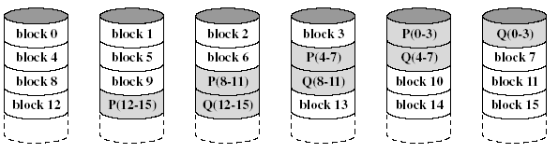
RAID 6

Slide 24
RAID Level 6
Two different parity calculations are carried out and stored in separate blocks on different disks.
  Example: XOR and an independent data check algorithm => makes it possible to regenerate data even if two disks containing user data fail.
No. of disks required = N + 2 (where N = number of disks required for data).
Provides HIGH data availability.
Incurs substantial write penalty as each write affects two parity blocks.
Three disks would have to fail within MTTR (mean time to repair) interval to cause data to be lost

Slide 25
Faster-Block level stripping
Provides fault tolerance up to two failed drives Fault tolerance- double distributed parity (backup of backup of data)
High availability systems
Failure of hard drive, slow down the performance of the system
Loose two hard disk space for parity
Incurs substantial write penalty

Slide 26
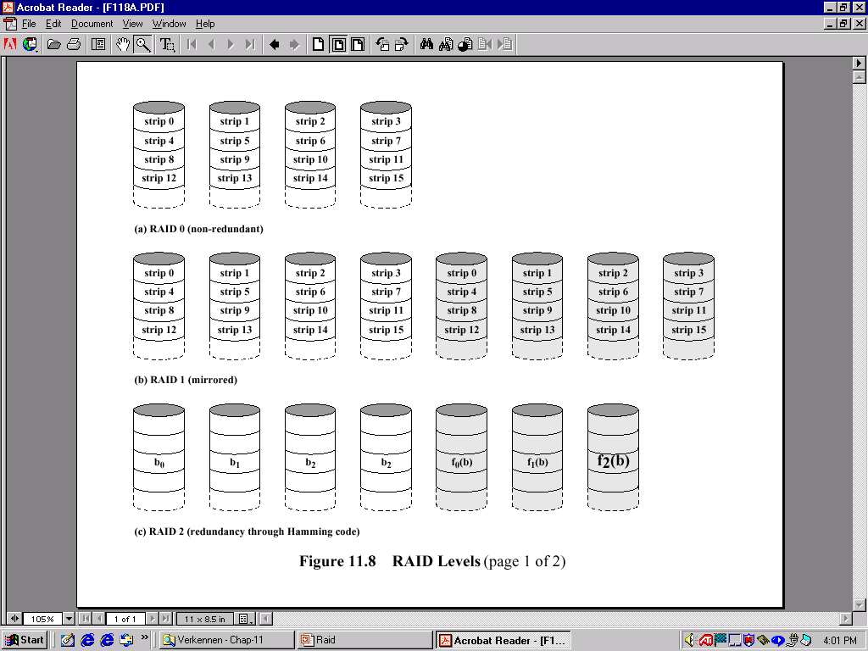
Overview Raid 0-2

Slide 27
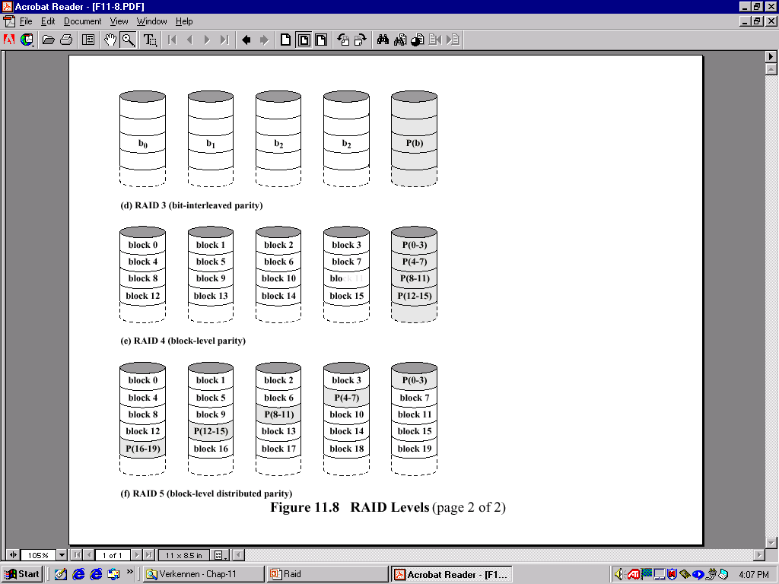
Overview Raid 3-5

